Slide 1

AMARARAJA BATTERIES– BOBBIN TRACKING SYSTEM
Genuine IT Solution

Slide 2
MODULES
MASTER
TRANSACTIONS
REPORTS

Slide 3
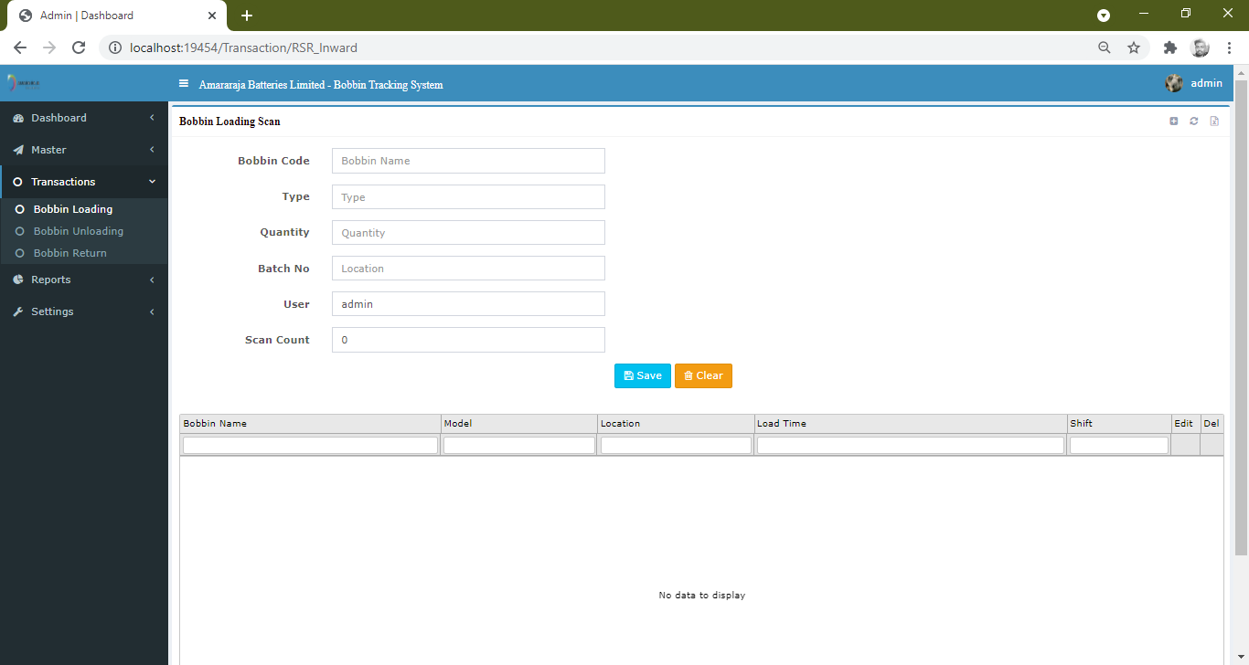
Modification – bobbin loading

Slide 4
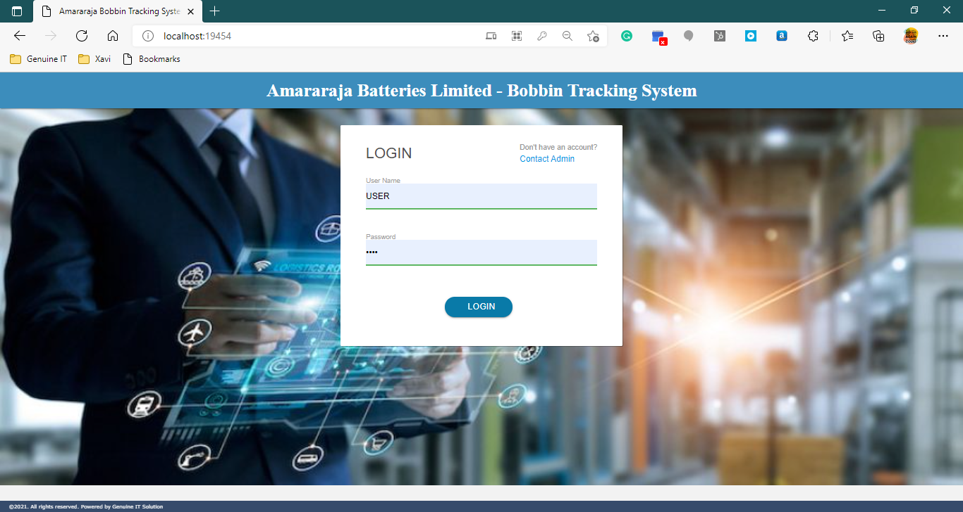
Login

Slide 5
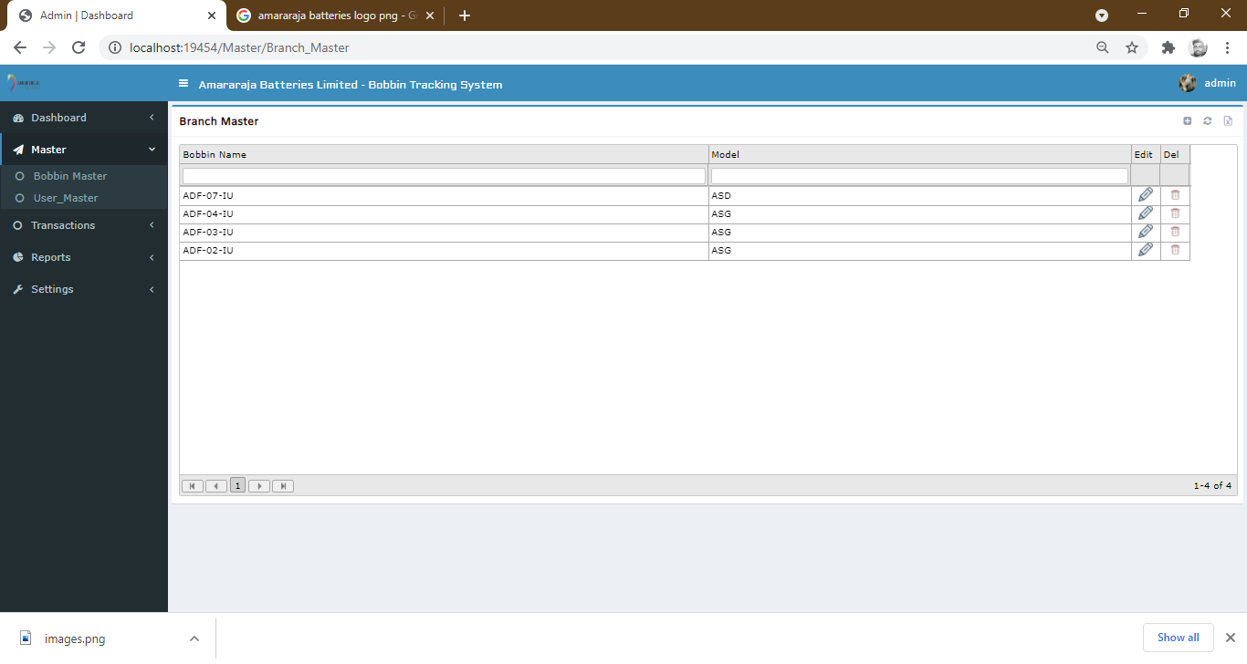
MASTER – BOBBIN MASTER

Slide 6
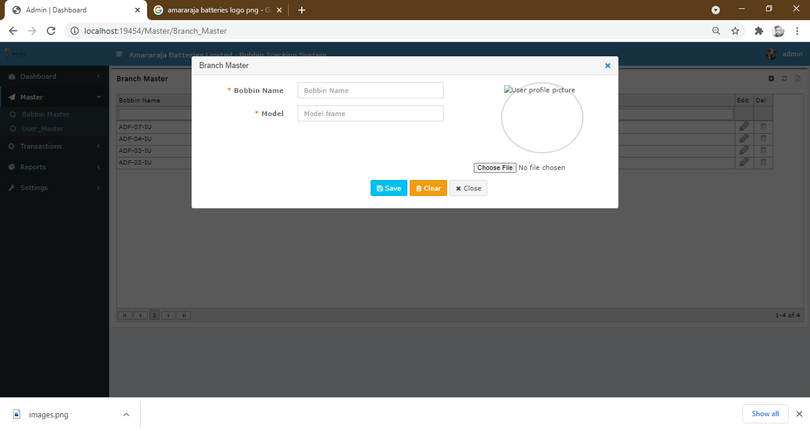
BOBBIN MASTER – ADD NEW BOBBIN

Slide 7
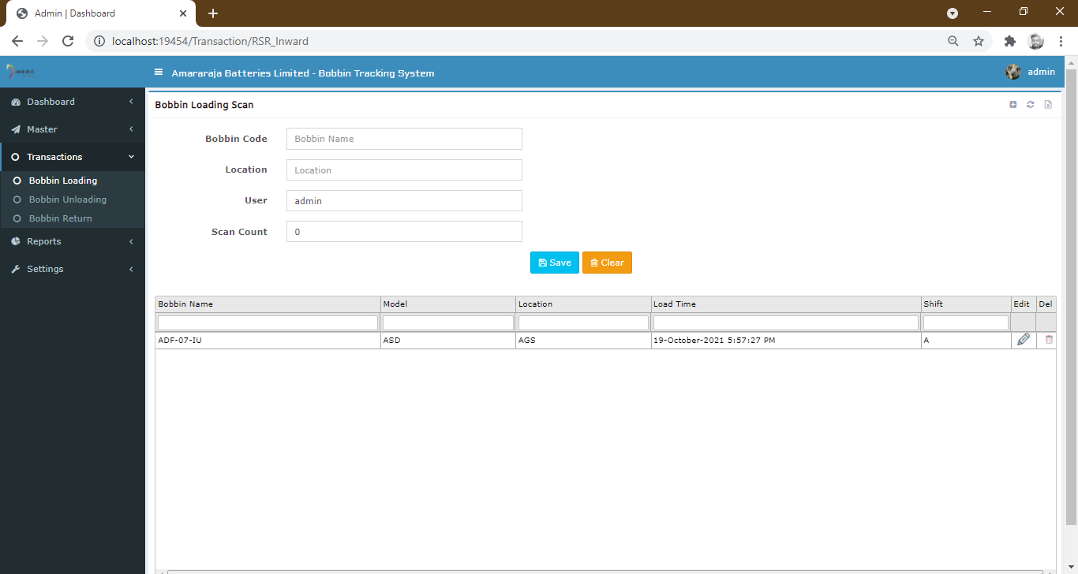
TRANSACTION – BOBBIN LOADING

Slide 8

TRANSACTION – BOBBIN UNLOADING

Slide 9
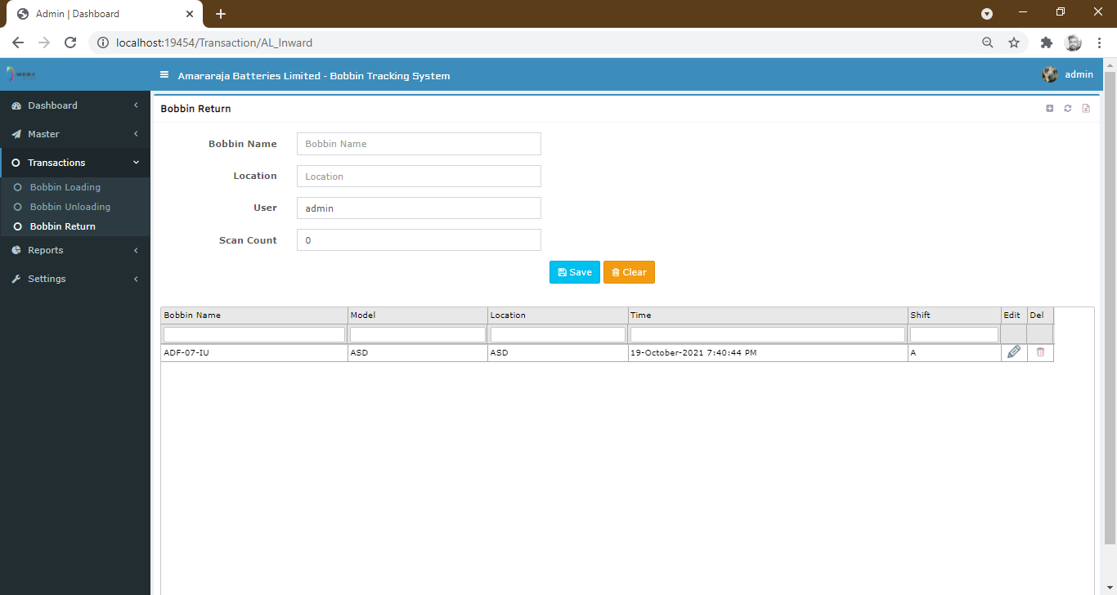
TRANSACTION – BOBBIN RETURN

Slide 10
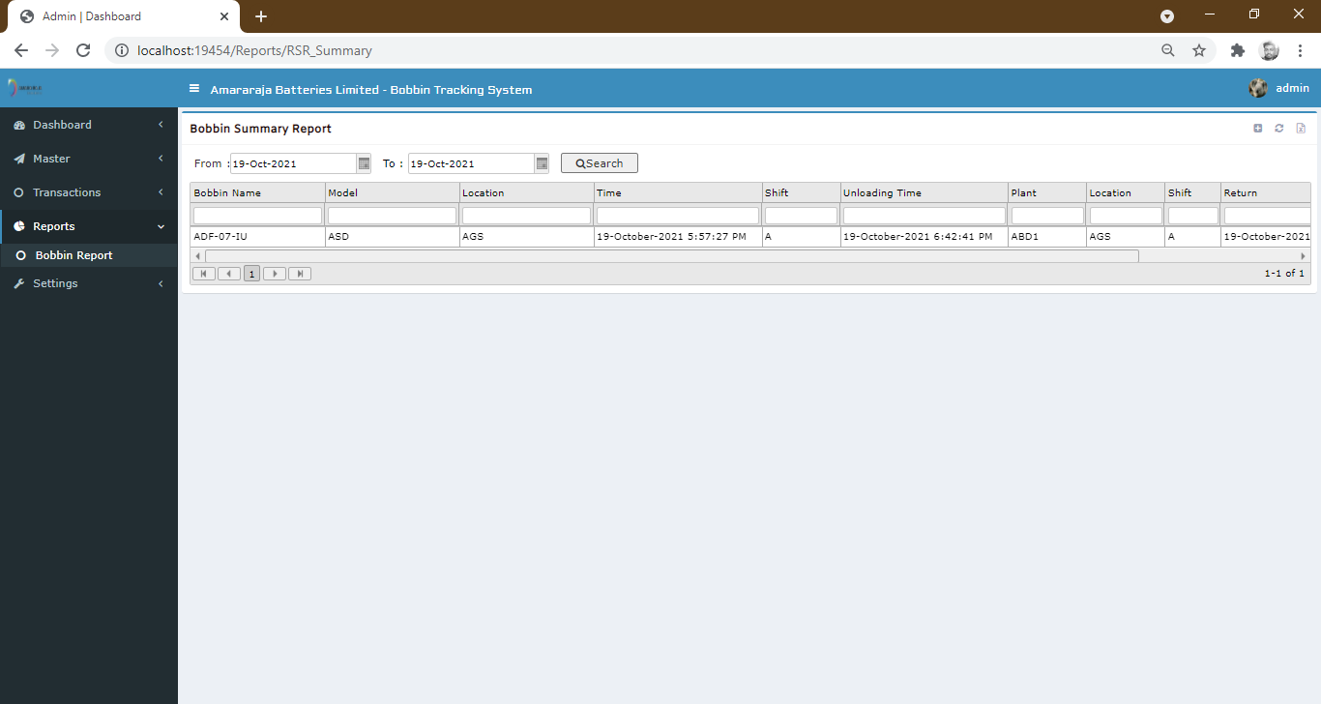
Report – bobbin summary report

Slide 11
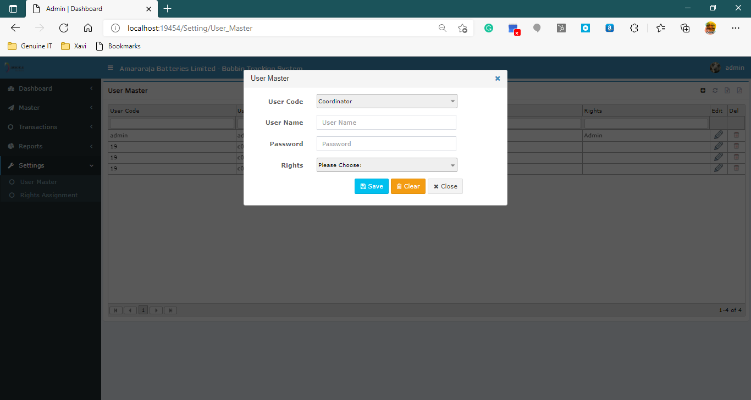
Settings – user master

Slide 12
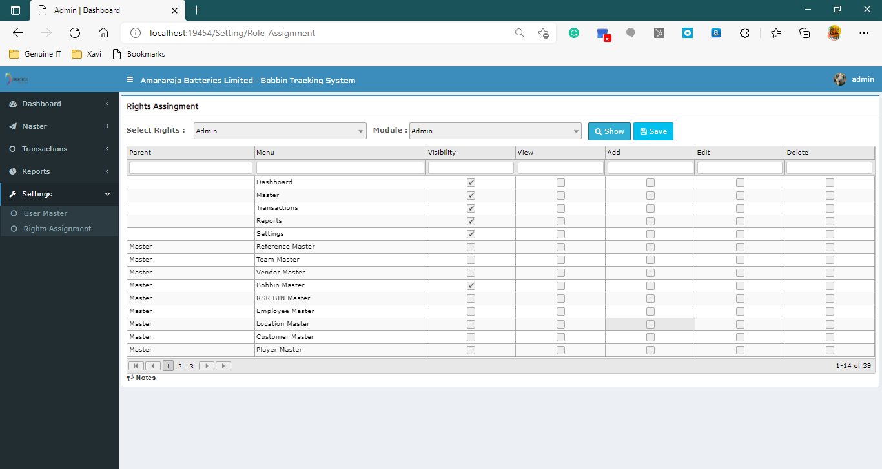
Settings – rights assignment

Slide 13

Thank you

